Slide 1



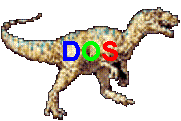



EEE 435
Principles of Operating Systems
Modeling Page Replacement Algorithms
(Modern Operating Systems 4.5)

Slide 2
Outline
Belady’s Anomaly
Algorithm Classes
The distance string
Predicting page fault rates

Slide 3
Belady’s Anomaly
Is it always better to have more page frames with respect to reducing the number of page faults?
  Intuitively, that makes sense
  In 1969 a group discovered a counterexample wherein the FIFO page replacement algorithm could generate more page faults with four page frames than with three
  This drove the academic bonkers...and led to the development of the theory behind paging algorithms and their properties

Slide 4
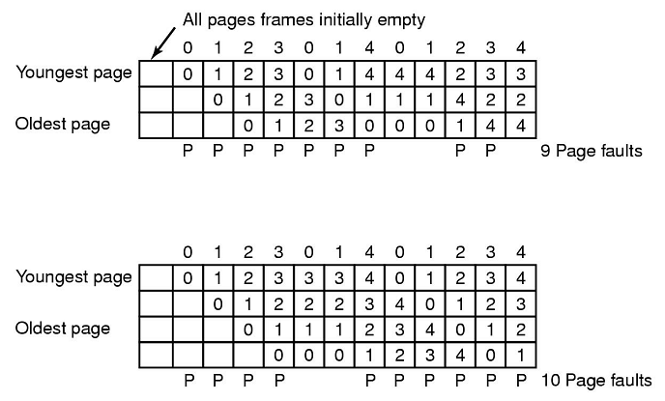
Belady’s Anomaly

Slide 5

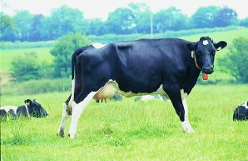
Algorithm Classes
We will consider only a single process
This process will generate a set of requests for virtual pages. This is known as the _________________
A paging system can be characterized by three items:
  The reference string of the executing process
  The page replacement algorithm
  The number of page frames in memory, m

Slide 6
Algorithm Classes
Using this information a model’s properties can be investigated by analyzing the manner in which pages are kept in memory
  Have an array, M, that keeps track of the state of memory. The array has n entries, which corresponds to the number of virtual pages
  The array has a “top part” with m entries which represents the pages in memory, and a “bottom part” of n-m entries, representing pages once loaded in memory, but that have since been swapped out

Slide 7
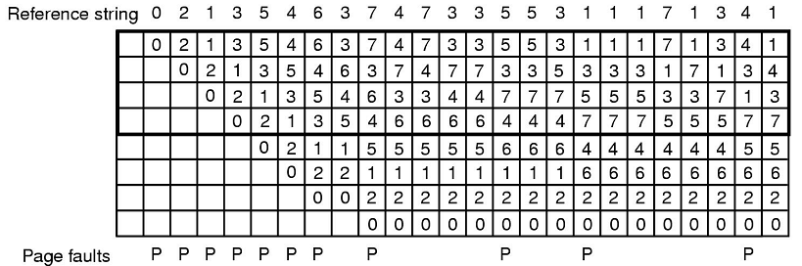
Algorithm Classes
Entries are “sorted” about in this list the same way they would be for their actual algorithm
  The algorithm being shown here is Least Recently Used. Each time a page is not in memory a page fault is indicated with a “P”

Slide 8
Algorithm Classes
Note how, for this example with LRU, that the set of pages in memory for 4 page frames would also be in with 5 page frames.
  There would be an additional page in memory, but the set of pages in memory for n page frames is also in memory for n+1 page frames
  Algorithms that meet this criteria are called stack algorithms. These algorithms do not suffer from Belady’s anomaly
    Mathematically, these algorithms have the property M(m,r)⊆M(m+1, r)

Slide 9
The Distance String
Stack algorithms are important since they allow for an easier mathematical analysis of page replacement algorithms
An interesting measure is how far from the top of the stack a page is when it is used
  This is known as the _______________
  So, if the “average” distance a page is from the top of the stack is 3, then we know that 4 or more page frames will result in few page faults.

Slide 10
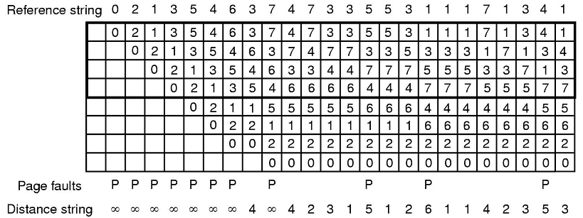
The Distance String
Pages that have not yet been loaded have a distance of infinity
Counting the frequency of occurrence of each distance string (and a little math) results in a probability density function

Slide 11
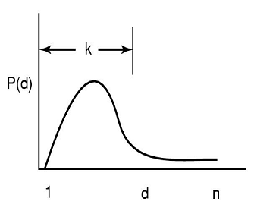
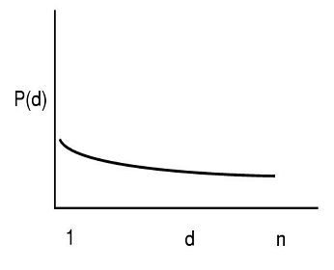
The Distance String
These are two hypothetical PD functions
  The left shows that most entries in the string are between 1 and k. With k page frames, few faults will occur
  The one on the right is not so lucky. The only way to avoid page faults is to have almost as many page frames as virtual pages

Slide 12
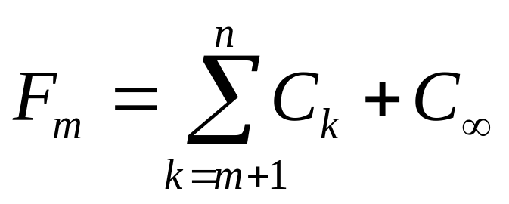
Predicting Page Fault Rates
The distance string also gives an easy way to predict page fault rates for a reference string for memories of different sizes
  Essentially, obtain a vector, C, of the number of times each number in the distance string occurs
  Then compute another vector, F, where each entry F_{x} is equal to the sum of C_{x+1} to C ∞
  Mathematically, F is computed as:
C₁ =
C₂ =
C₃ =
C₄ =
C₅ =
C₆ =
C₇ =
C∞ =

Slide 13
Predicting Page Fault Rates
C₁ =
C₂ =
C₃ =
C₄ =
C₅ =
C₆ =
C₇ =
C∞ =
F₁ =
F₂ =
F₃ =
F₄ =
F₅ =
F₆ =
F₇ =
F∞ =
So, one page frame would result in 20 faults, two would result in 17, three in 14, etc...
THIS IS ONLY TRUE IF BELADY'S ANOMALY DOES NOT APPLY!

